Slide 1


Madanapalle Institute of Technology & Science, Madanapalle UGC-AUTONOMOUS INSTITUTION Affiliated to JNTUA, Ananthapuramu & Approved by AICTE, New Delhi
Department of Computer Science & Technology
Review: Final Review Project Viva Voce
“A Dynamic Donation Allocation and Validator Accountability Mechanism For Effective Charity Process Using Blockchain Technology ”
Under the Guidance of
Presented by
Dr. Praveena N
Assistant Professor/CST
21691A2893-Y.Mohan Kumar
21691A28C1-A.Pradeep Kumar Reddy
21691A28C6-N.Prasanth Reddy
21691A28D1-P.Purushotham

Slide 2
CONTENTS
Abstract
Scope & Objectives of the Project
Literature Survey
Research Gap
Architecture Diagram, Module diagram
Input & Expected outcome
Proposed Methodology
Algorithm used in detail
Project Design - UML diagrams or any other diagram
Implementation & Demo
Comparison
Conclusion
References

Slide 3
ABSTRACT
Emergencies like pandemics and natural disasters demand a global response to aid affected communities, but traditional charity systems often lack transparency, deterring donors due to concerns about fund misuse. Blockchain technology (BCT), particularly the Ethereum blockchain, provides a transformative solution by enabling secure, traceable, and immutable transactions without intermediaries. Donors can track their contributions, ensuring transparency and accountability. A Dynamic Donation Allocation and Validator Accountability Mechanism is proposed, integrating smart contracts with a hybrid consensus model. The system introduces a reputation-based validator mechanism that evaluates and manages the trustworthiness of nodes, preventing malicious activities and ensuring reliability. By combining automated fund disbursement through smart contracts and secure validation using advanced consensus protocols, this solution bridges gaps in transparency, efficiency, and trust. It enhances resource allocation, reduces fraud, and ensures timely aid delivery, ultimately rebuilding donor confidence and supporting recovery efforts.
Keywords: Blockchain, Ethereum, Smart Contracts, Dynamic Fund Allocation, Validator Reputation System, Transparency, Security, Charity Platforms.

Slide 4
OBJECTIVES OF THE PROJECT
To design a blockchain-based framework to make the donation process more transparent.
To ensure the security , safety and trust of charitable transactions by various stakeholders.
To improve Transaction speed and reduce the cost of system.
To assess and contrast the performance of proposed framework with Bench mark system
Performance Metrics:
Privacy , Transparency, Tracking of Payments ,cost , speed

Slide 5
SCOPE
Trust: Enhance donor trust by using blockchain to ensure full transparency, allowing donors to track their contributions in real-time and confirm funds are used as intended.
Efficient Fund Allocation : Automate the allocation of funds through smart contracts, ensuring quick, accurate, and efficient distribution based on real-time data, such as disaster severity or beneficiary needs.
Automation of Processes : Minimize human intervention by automating donation tracking, fund distribution, and impact reporting, improving consistency and reducing errors in the donation process.
Decentralized Donation Platform : Create a blockchain-based system where all transactions and activities are managed in a decentralized manner. Eliminate the need for a central authority, ensuring transparency and autonomy for donors and charities.
5. Immutable Records : Use blockchain’s decentralized ledger to store donation details, campaign progress, and fund allocations.Ensure all records are immutable, providing trust and accountability to users.

Slide 6
RESEARCH GAP
Lack of Transparency and Accountability
Inefficient Fund Disbursement
Security and Scalability Issues
Limited Real-Time Data Integration
Donor Confidence and Impact Reporting

Slide 7
LITERATURE SURVEY
S.No | Year | Title of the Paper | Authors | Algorithm used | Metrics | Advantages | Disadvantages
1 | 2024 | Blockchain Oriented Effective Charity Process During Pandemics and Emergencies | Mandeep Kaur,Pankaj Deep Kaur,and Sandeep Kumar Sood | Proof of Authority (PoA), Blockchain, Ethereum,Smart contracts,solidity | Processing Time,Transaction Validity,GasTransparency | Transparency Traceability, Eliminates Intermediaries. | Proof-of-Authority (PoA) Scalability Limitations , Energy Efficiency
2 | 2024 | Enhancing Donor Trust Through a Blockchain-Based Traceability Model for Charitable Contributions | Andry Alamsyah, Serly Aulia Amanda | Blockchain technology, smart contracts, Polygon Matic (Ethereum-compatible platform), Decentralized Applications (Depp’s) | Transparency,immutability, traceability. | Increased Donor Trust, Improved Transparency and Accountability, Tax Deduction Claims | implementation Complexity. Costs of Technology, Need for User Education ,Selecting a Suitable Blockchain Platform

Slide 8
S.No | Year | Title of the Paper | Authors | Algorithm used | Metrics | Advantages | Disadvantages
3 | 2024 | Fund Tracking System using Blockchain Technology | Anupama B Shriya Jaiswal , Akash Ranjan Das , Sunitha N R , Navdeep Rattan | Proof of Authority (PoA),PBFT (Practical Byzantine Fault Tolerance),SHA-256,Technology Used: Blockchain, Ethereum | Efficiency, Transparency. | High Transparency, Secure Data Integrity, Decentralized and Distributed Ledger, Manipulation Not Allowed | High Energy Consumption ,Centralized Control, High Computational Cost
4 | 2022 | Crowdfunding Charity Platform Using Blockchain | Dr. S. Saranya, Sai Phanindra Muvvala, Vitul Chauhan, Raja Satwik | Depth First Search (DFS),Proof of Work (Pow),Technology Used: Blockchain Technology Ethereum, Smart Contracts, Graph Data Structure (Ethereum Virtual Machine) | Reduced Costs and Faster Transactions, Efficiency in User Search,Security,Transparency. | Immutability, Decentralized Structure, User Privacy, Transparency | High Transaction Fees ,Scalability and Efficiency

Slide 9
S.No | Year | Title of the Paper | Authors | Algorithm used | Metrics | Advantages | Disadvantages
3 | 2024 | Fund Tracking System using Blockchain Technology | Anupama B Shriya Jaiswal , Akash Ranjan Das , Sunitha N R , Navdeep Rattan | Proof of Authority (PoA),PBFT (Practical Byzantine Fault Tolerance),SHA-256,Technology Used: Blockchain, Ethereum | Efficiency, Transparency. | High Transparency, Secure Data Integrity, Decentralized and Distributed Ledger, Manipulation Not Allowed | High Energy Consumption ,Centralized Control, High Computational Cost
4 | 2022 | Crowdfunding Charity Platform Using Blockchain | Dr. S. Saranya, Sai Phanindra Muvvala, Vitul Chauhan, Raja Satwik | Depth First Search (DFS),Proof of Work (Pow),Technology Used: Blockchain Technology Ethereum, Smart Contracts, Graph Data Structure (Ethereum Virtual Machine) | Reduced Costs and Faster Transactions, Efficiency in User Search,Security,Transparency. | Immutability, Decentralized Structure, User Privacy, Transparency | High Transaction Fees ,Scalability and Efficiency

Slide 10
S.No | Year | Title of the Paper | Authors | Algorithm used | Metrics | Advantages | Disadvantages
7 | 2021 | A Secured Distributed Ledger Based Fundraising Framework Using Smart Contracts | Darshan M,S.R Raswanth, Sundeep V V S Akella, Priyanka Kumar | Proof of Work,Technologies used: Block chain,Smart Contracts | Traceability, Immutability | Increased transparency and accountability in charity systems,Enhanced trust factor for donors,Scalability | Challenges in integrating CSR models,Limited reach in regions with low internet penetration
8 | 2020 | Aid, Charity, and Donation Tracking System Using Blockchain | Aashutosh Singh, Rohan Rajak, Prachi Raut, Harsh Mistry | Elliptic Curve Digital Signature Algorithm (ECDSA),Proof of Authority, Technology Used: Blockchain Technology, Ethereum & Ethereum Virtual Machine (EVM),ReactJS | Improved efficiency: Transparency, Reduced operational costs: | Transparency, Traceability, Security, Reduced Corruption, Decentralization | Gas Fees for Transactions, Immutability Challenges

Slide 11
S.No | Year | Title of the Paper | Authors | Algorithm used | Metrics | Advantages | Disadvantages
9 | 2019 | Proposed Solution for Trackable Donations using Blockchain | N. Sai Sirisha, Tarasha Agarwal, Ranjeet Monde, Richa Yadav, Mrs. Rupali | Byzantine consensus, Cryptographic Hash Functions Technology Used: Blockchain, Ethereum,IPFS, Smart contracts | Transparency:Traceability,Tamper-resistance. | Transparency,Traceability. | High Computational Costs,Gas Costs.
10 | 2019 | Platform for Tracking Donations of Charitable Foundations Based on Blockchain Technology | Hadi Saleh, Sergey Avdoshin, Azamat Dzhonov | Cryptographic Algorithms,PoW, LPoS, DPoS, BFT Technology Used:Blockchain (Ethereum),Smart Contracts (Solidity),Node.js | Transparency,Reporting, Trust, tracking | Secure data integrity,Simplified reporting,Reduced criticism | Energy inefficiency,Scalability challenges,Hard drive space usage

Slide 12
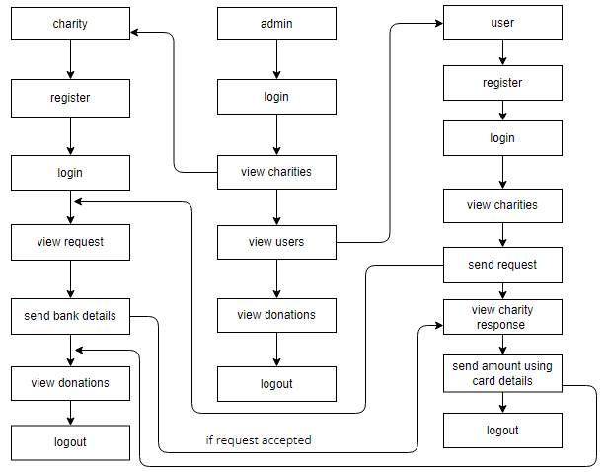
MODULE DIAGRAM

Slide 13
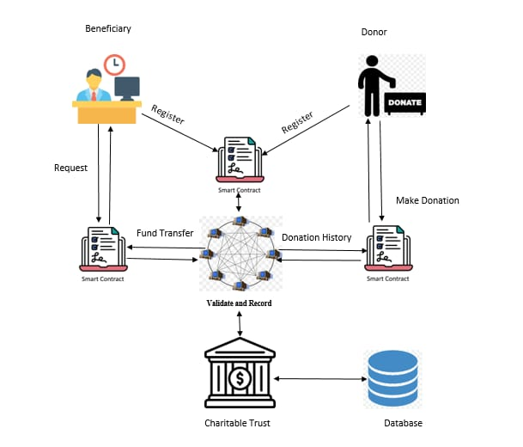
ARCHITECTURE DIAGRAM

Slide 14
Existing system
The existing system uses Proof of Authority (PoA) blockchain to manage donations for disaster or pandemic-affected communities. It ensures secure, transparent, and traceable transactions using smart contracts. The system has three main participants: beneficiaries (people in need), donors (who contribute funds), and charitable trusts (organizations managing donations). Beneficiaries request help, and charitable trusts verify and distribute funds or essential supplies. Donors can track their donations and receive updates when funds are used. The PoA consensus mechanism allows only a few trusted authority nodes to validate transactions, making the system fast and cost-effective. However, it has some disadvantages, such as semi-centralization, limited validator participation, potential security risks, and scalability challenges. While gas fees are lower than traditional blockchains, they may increase during high network activity. The system provides a reliable and efficient way to manage donations, but it needs improvements in decentralization and scalability, which will be addressed in the hybrid PoA-PoS upgrade.

Slide 15
Proposed System
The proposed system improves the PoA-based charity donation platform by integrating a hybrid PoA-PoS model, along with Ganache, MySQL, and smart contracts for secure and efficient transactions. PoA ensures fast approvals through trusted authority nodes, while PoS increases decentralization and security by allowing validators to stake funds. This combination makes transactions safer, scalable, and transparent, allowing donors to track their contributions and beneficiaries to request aid securely.
Ganache provides a local blockchain environment for testing transactions and smart contracts before deployment, ensuring reliability. MySQL stores off-chain data, such as user details, transaction logs, and donation records, making information management easier and reducing blockchain costs. Smart contracts automate fund transfers, ensuring they are tamper-proof and secure, eliminating intermediaries.
The system also optimizes transaction fees, reducing unnecessary costs and making donations more accessible. By combining PoA, PoS, Ganache, MySQL, and smart contracts, the system enhances speed, security, transparency, and efficiency, ensuring that every donation reaches the right beneficiaries safely and can be fully traced

Slide 16
ALGORITHM USED IN DETAIL
The hybrid PoA-PoS charity donation system starts by deploying Ganache for testing, MySQL for off-chain data storage, and smart contracts on Ethereum. Users (donors and beneficiaries) register on the platform, where PoA validators quickly verify and approve them. Donors select beneficiaries and make donations, which are locked in smart contracts. PoA ensures fast approvals, while PoS validators confirm transactions and add them to the blockchain. Beneficiaries can request aid, and funds are securely transferred after PoA and PoS validation. Transactions are recorded on-chain for transparency, while MySQL stores donor details to reduce blockchain costs. The system is tested in Ganache before deployment, ensuring secure, low-cost, and transparent donations.

Slide 17
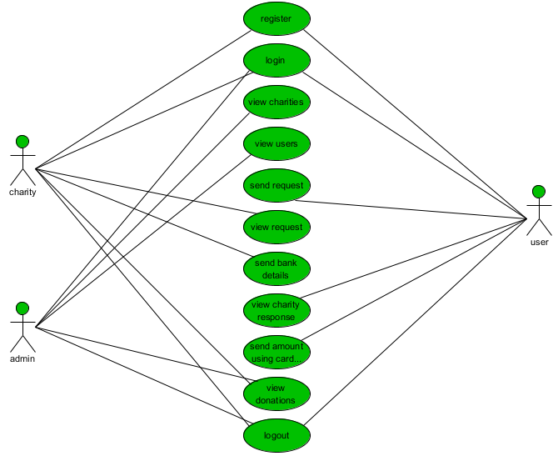
PROJECT DESIGN - USE CASE DIAGRAM

Slide 18
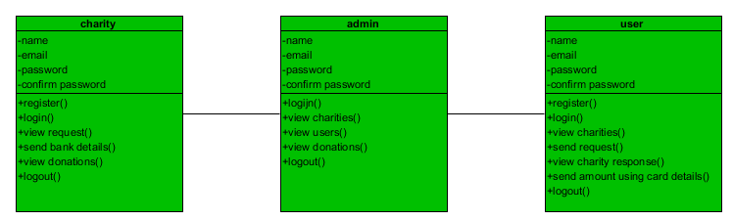
CLASS DIAGRAM

Slide 19
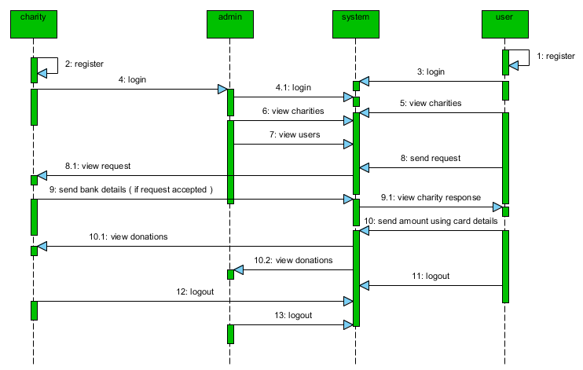
SEQUENCE DIAGRAM

Slide 20
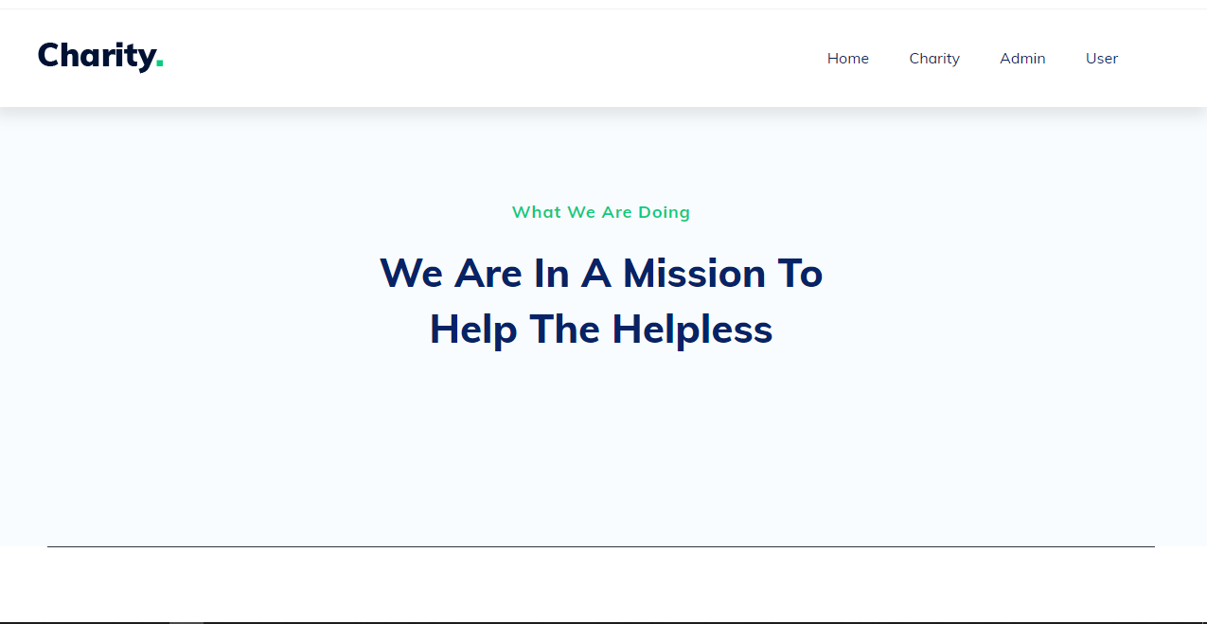
IMPLEMENTATION:
Home Page:

Slide 21
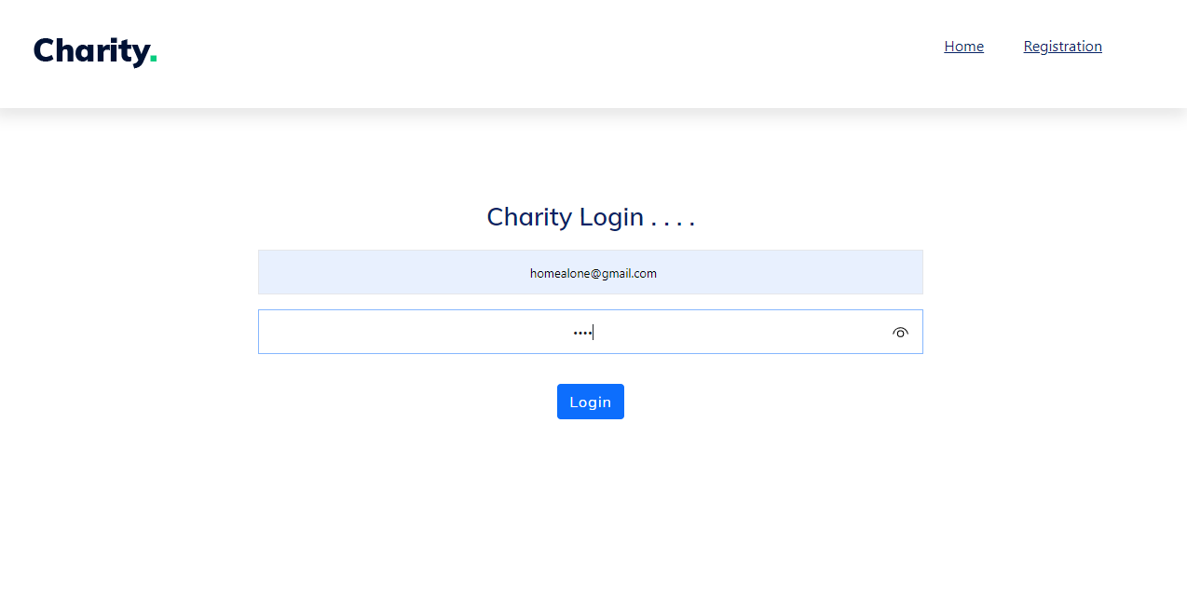
IMPLEMENTATION:
Charity Login Page:

Slide 22
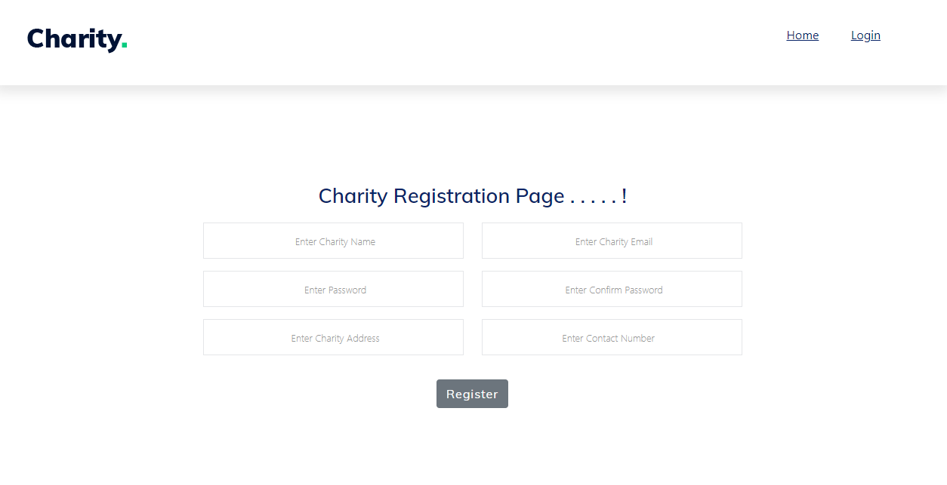
IMPLEMENTATION:
Charity Registration Page:

Slide 23
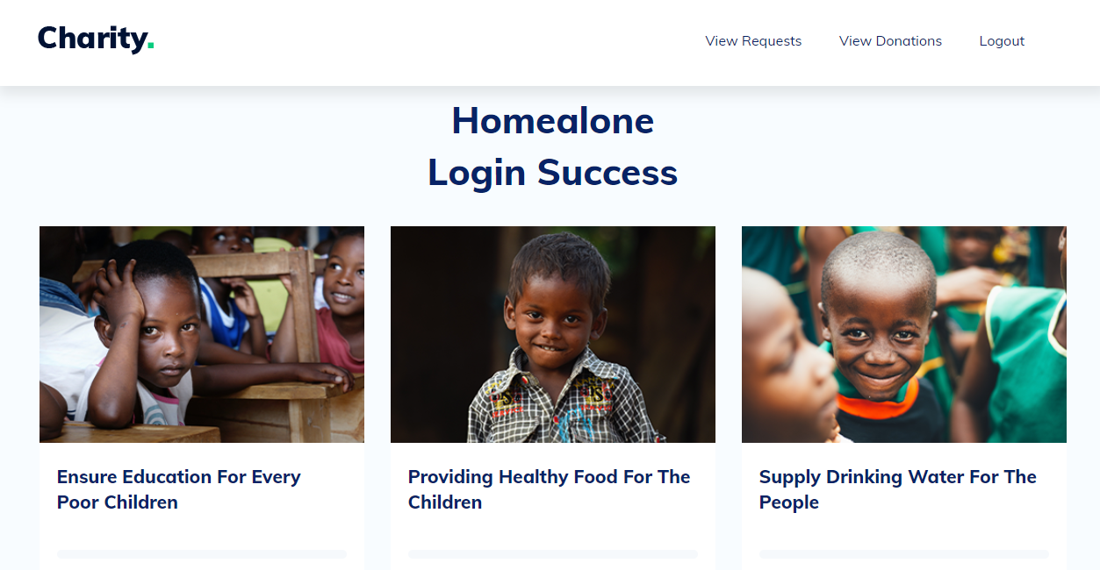
IMPLEMENTATION:
Charity Home Page:

Slide 24
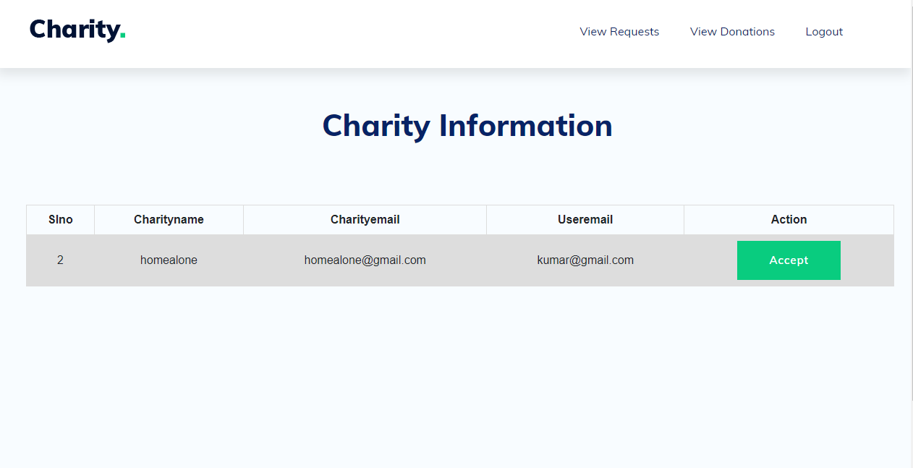
IMPLEMENTATION:
User request:

Slide 25
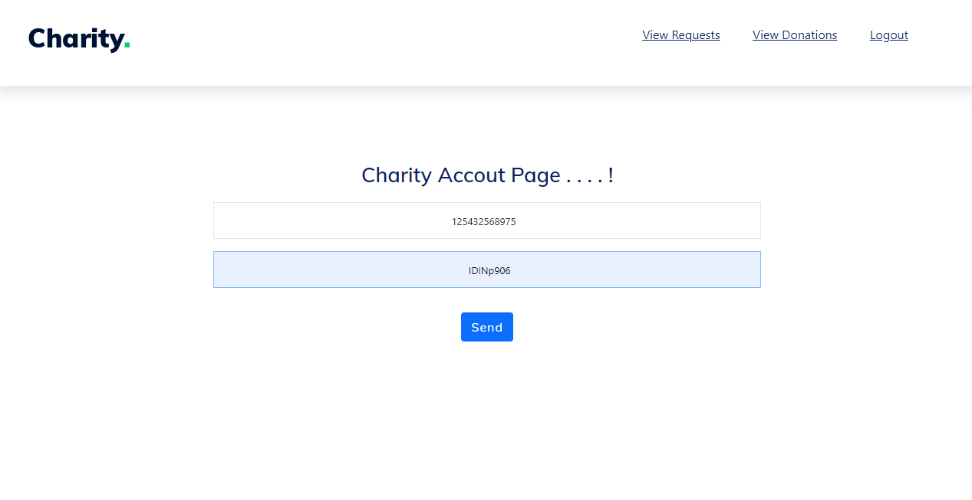
IMPLEMENTATION:
Charity Account Page:

Slide 26
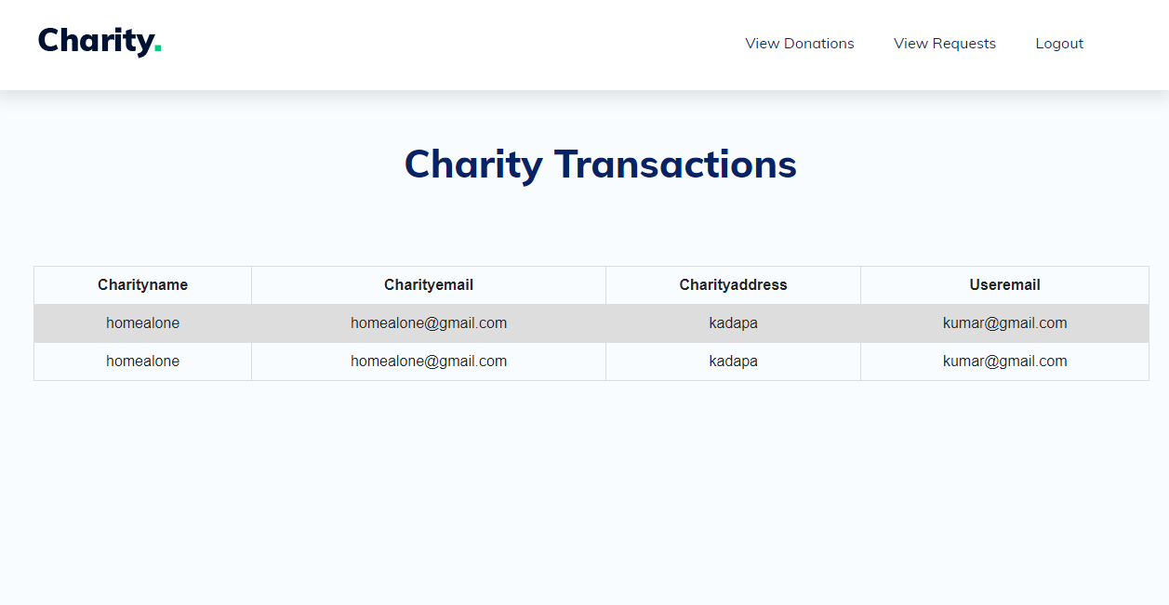
IMPLEMENTATION:
View Donations:

Slide 27
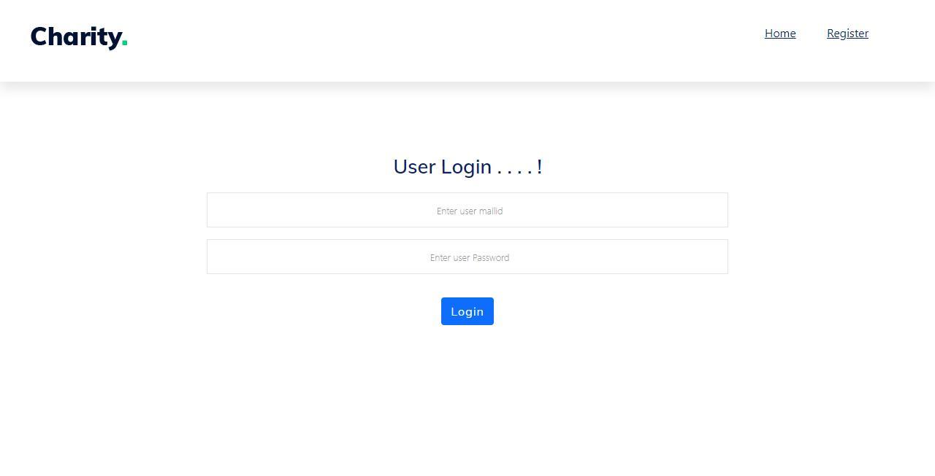
IMPLEMENTATION:
User Login Page:

Slide 28
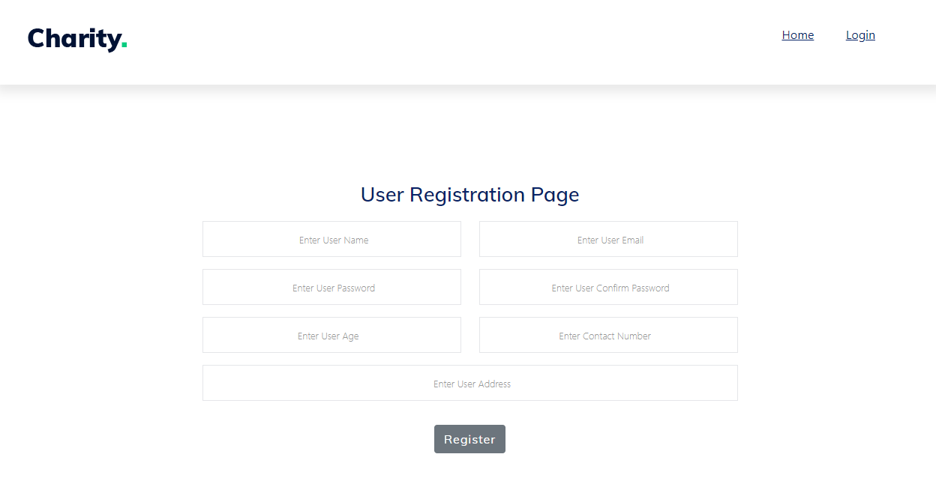
IMPLEMENTATION:
User registration Page:

Slide 29
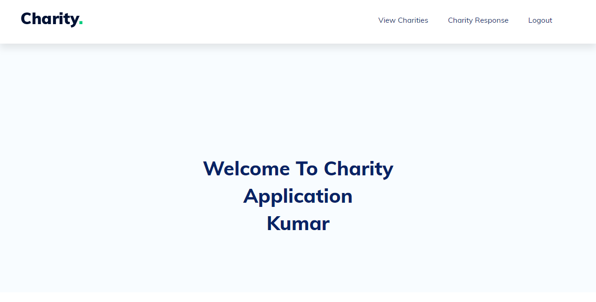
IMPLEMENTATION:
User Home Page:

Slide 30
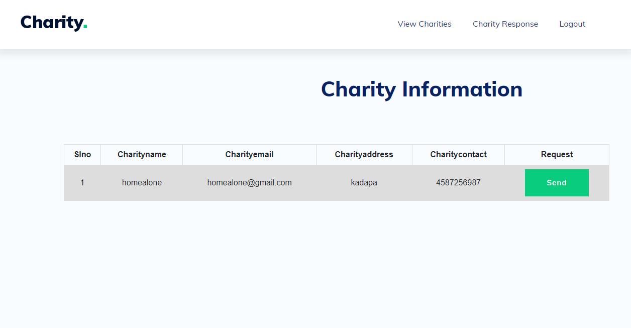
IMPLEMENTATION:
View Charities:

Slide 31
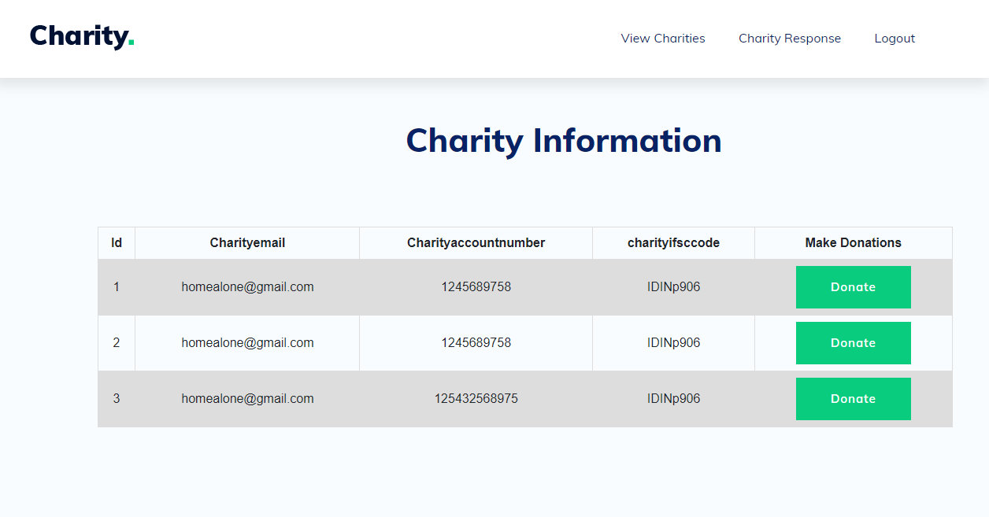
IMPLEMENTATION:
Charity Response:

Slide 32
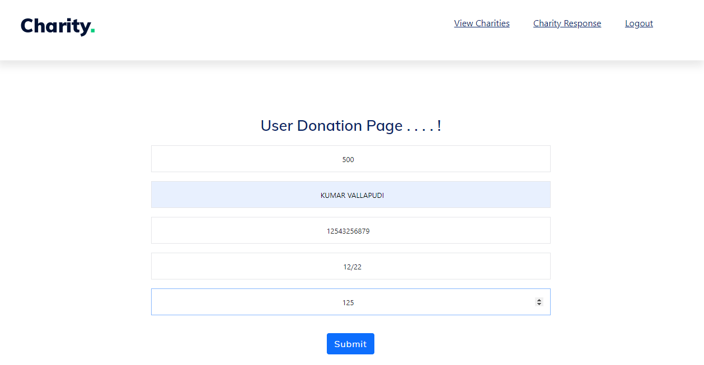
IMPLEMENTATION:
User Transaction:

Slide 33
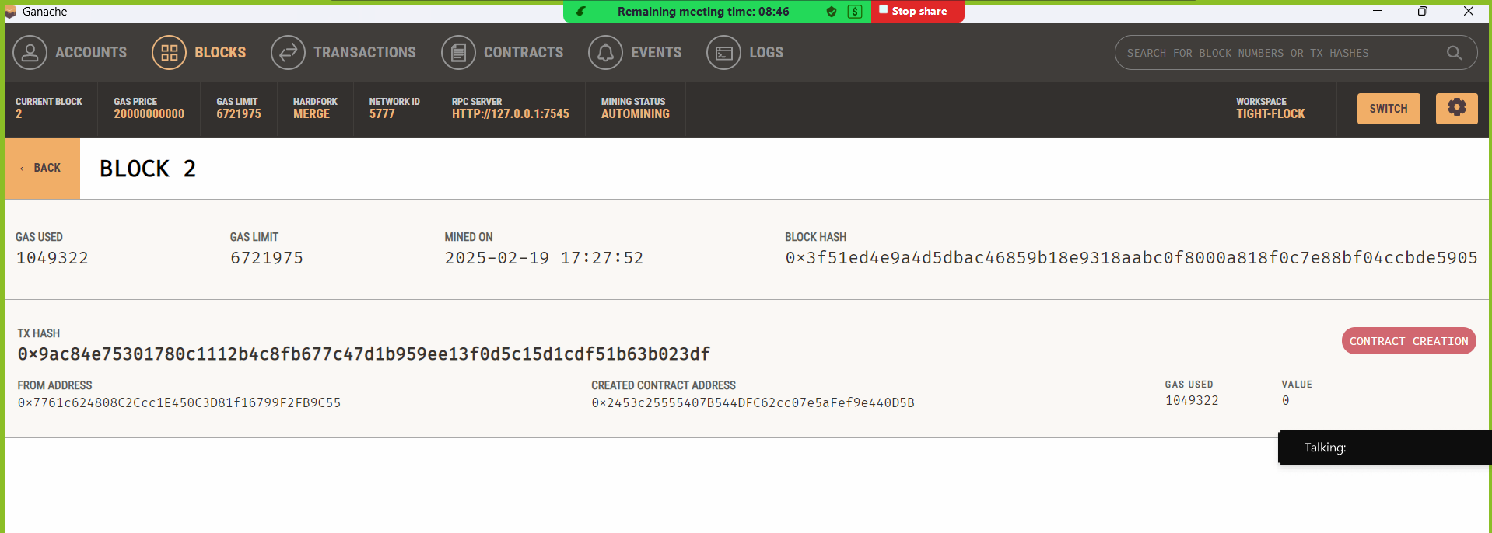
IMPLEMENTATION:
Genache Time Stamp Etherium

Slide 34
METRICS COMPARISON
Performance Metric | Existing PoA System
Transaction Speed | High
Cost Efficiency (Gas Fees) | High
Scalability | Low
Security | High
Privacy | Low
Tracking of Payments | Less Transparent
Decentralization | Low
Performance Metric | Proposed Hybrid PoA-PoS System
Transaction Speed | Higher
Cost Efficiency (Gas Fees) | More Optimized
Scalability | High
Security | Higher
Privacy | More Secure
Tracking of Payments | More Transparent
Decentralization | Higher

Slide 35
CONCLUSION
The integration of blockchain technology into the charity donation ecosystem introduces a paradigm shift toward a transparent, decentralized, and accountable framework. This research presents a complete solution aimed at enhancing the integrity of the donation process by recording each transaction on an immutable ledger, thereby eliminating concerns regarding misuse and lack of transparency. By utilizing smart contracts and a decentralized ledger, the proposed system ensures that every contribution is traceable and reaches its intended recipient without relying on third-party intermediaries. This builds trust among donors, improves fund management for NGOs, and provides clear visibility for beneficiaries. The implementation of this blockchain- based donation platform establishes a solid foundation for innovation in the non-profit sector. Planned future developments include the integration of a secure payment gateway, feedback and rating mechanisms for donors, and a centralized dashboard for NGOs to showcase project status and fund utilization.

Slide 36
REFERENCES
Anupama B S, Akash Ranjan Das, Sunitha N R, Navdeep Rattan, Riya Jaiswal, "Fund Tracking System using Blockchain Technology." IEEE Transactions on Blockchain Technology, 2023.
Mohammed, M., & Patel, R. "Blockchain-Based Charity Platforms: Enhancing Trust and Reducing Fraud." Blockchain in Charity and Non-Profit Sectors 8.1 (2023): 45-58.
Zohar, M., & Ben-Zur, A. "Blockchain for Social Good: Revolutionizing Charitable Donations." Journal of Social Innovation 5.2 (2022): 123-135.
Dr.S. Saranya, Sai Phanindra Muvvala, Vitul Chauhan, Raja Satwik,"Crowdfunding Charity Platform Using Blockchain." IEEE Transactions on Blockchain Technology, 2022
Wei, L., & Zhao, X. "Leveraging Smart Contracts for Transparent Charitable Donations." Journal of Blockchain Technology and Applications 7.1 (2022): 112-125.
Adhikari, R., & Kothari, V. "Blockchain in Non-Profit and Charitable Sector: Challenges and Opportunities." Journal of Blockchain Research 10.4 (2021): 201-215.

Slide 37
REFERENCES
Gubaev Renat, Anton Peresichansky, Alexandr Belenov, Artem Barger "Karma - Blockchain Based Charity Foundation." IEEE Transactions on Blockchain Technology, 2021.
Buntin, M., & Lincoln, P. "Blockchain Applications in Charitable Fundraising: Case Studies and Future Trends." Journal of Non-Profit Technology 14.3 (2020): 74-89.
Aashutosh Singh, Rohan Rajak, Harsh Mistry, Prachi Raut, "Aid, Charity, and Donation Tracking System Using Blockchain." IEEE Transactions on Blockchain Technology, 2020.
Sai Sirisha.N,Agarwal, T. Monde, R. Yadav, R, & Hande, R., "Proposed Solution for Trackable Donations using Blockchain." IEEE Transactions on Blockchain Technology, 2019.

Slide 38


